Slide 1

Introduction to AI and Neural Networks
Presented By: Date : 25/9/2019
Mariam Harfouch
Marianne Abi Kanaan

Slide 2
Overview
Intro to Artificial Intelligence
AI fields and domains
Data Science
Machine Learning
Applications of AI Tools
Libraries
Structuring a Data Science project
Predictive Models
Deep Learning
Shallow vs Deep Neural Networks
Type of Deep Neural Networks
Keras vs Pytorch vs Tensorflow
Building the parts of our algorithm
Regression Model with Keras

Slide 3
Intro to Artificial Intelligence
Artificial Intelligence (AI) can: process data, recognize hidden patterns, learn from experience, perform human-like tasks, adjust to unseen input …
Types of AI:
Narrow AI ➔ In a specific field, single task. E.g. Speech Recognition
General AI ➔ Performs multiple tasks, as intelligent as humans E.g. defeating humans at Chess
Super Intelligent AI ➔ Smarter than humans (nonexistent yet)

Slide 4
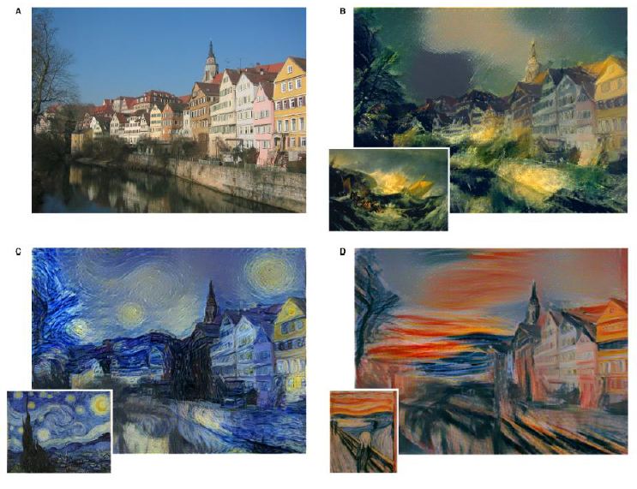
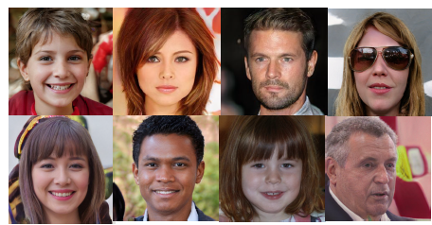
Applications of AI
Style Transfer: using Computer Vision, Convolutional Neural Networks (CNNs) …
Auto Tagging: using Natural Language Processing (NLP) …
Facial Recognition: using Computer Vision, Deep Learning …
Chatbots: using NLP
Face Generation: using Neural Networks https://thispersondoesnotexist.com/

Slide 5
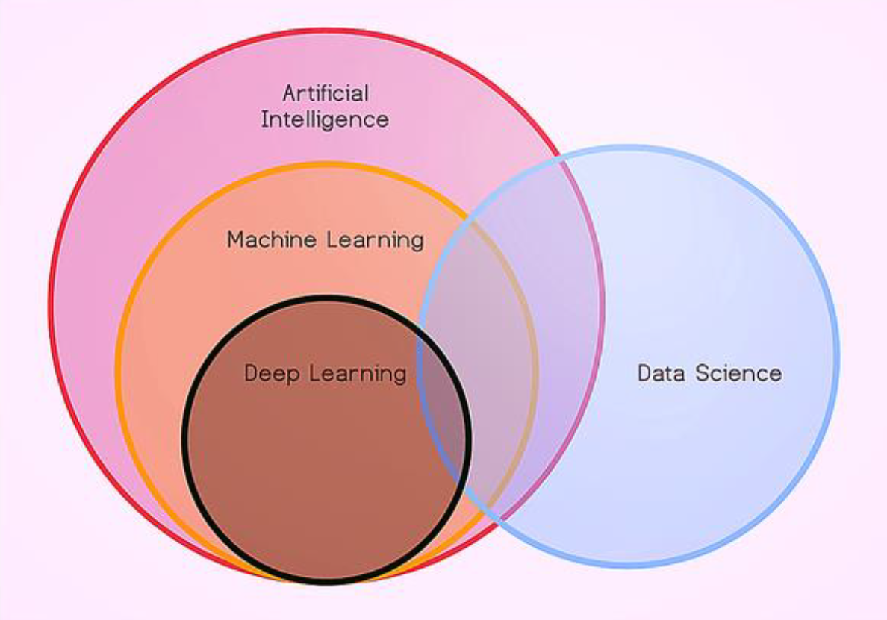
AI fields and domains

Slide 6
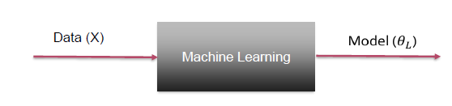
Machine Learning
Machine Learning is set of algorithms that parse data, learn from them, and then apply what they’ve learned to make intelligent decisions.
Types of ML:
Regression: deals with numerical data , E.g. predicting a customer’s purchase.
Classification: deals with categorical data, output is a category/class, E.g. Dog detection.
Supervised Learning: output is known, E.g. predicted price is close to actual price.
Unsupervised Learning: output is unknown E.g. finding clusters in the data.

Slide 7
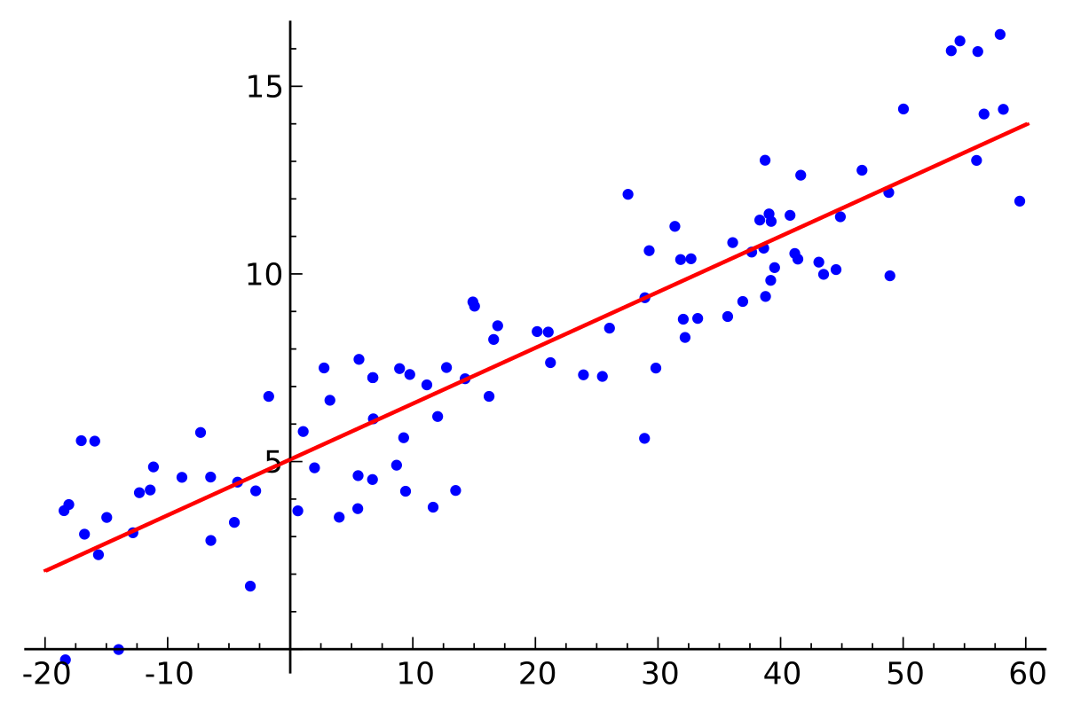
Numerical Predictive Models
Linear Regression:
Finds best fitting line between inputs (X) and outputs (Y).
Best line is the one with minimal error (error = predicted output – expected output)
E.g. Inputs are features (age of the house, area, location …) output is the predicted price that this house will be sold for.

Slide 8
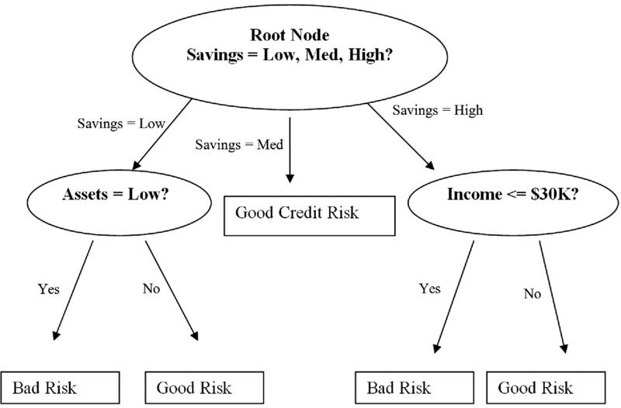
Categorical Predictive Models
Decision Trees:
Target output is a category, used to make a decision, classification
Used when features are systemically checked
Regression and Neural Networks are better for numerical outputs

Slide 9
Deep Learning
Deep Learning is a series of methods that try to solve some machine learning problems using deep neural networks.
A deep neural network is a neural network which often uses specific mathematical modeling in each layer to process data.

Slide 10
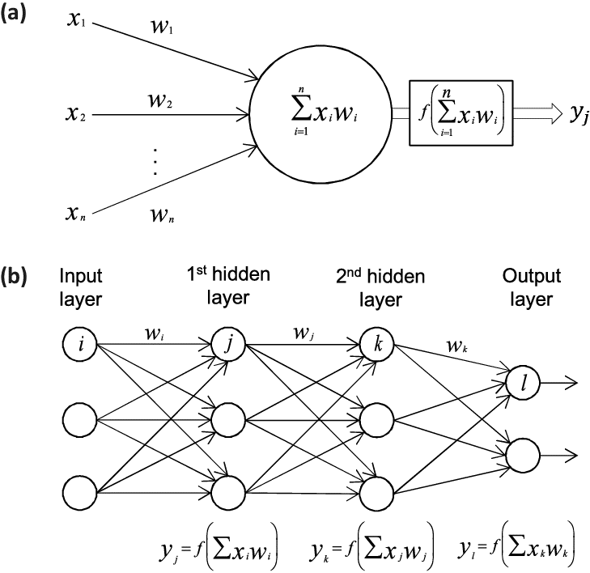
Shallow vs Deep Neural Networks
Shallow neural network consists of one hidden layer.
A deep neural network consists of more hidden layers and has a large number of neurons in each layer.

Slide 11
Type of Deep Neural Networks
Convolutional Neural Networks (CNN) : used in image recognition, object detection, and computer vision applications.
Recurrent Neural Networks (RNN): tries to solve the problem of modeling sequential data.
Restricted Boltzmann Machine (RBM) : are used to find the patterns in data in an unsupervised manner.
Deep Belief Networks (DBN) : was invented to solve the back-propagation problem, that can often cause “local minima” or “ vanishing gradients” issues in the learning process.
Autoencoders : An autoencoder is a type of unsupervised learning algorithm that will find patterns in a dataset by detecting key features.

Slide 12
Keras vs Pytorch vs Tensorflow
Tensorflow is the most popular deep learning library, developed by Google.
Pytorch is a cousin of the Lua-based Torch framework, and is a strong competitor to Tensorflow.
Keras is the easiest API on top of Tensorflow to be used.

Slide 13
Building a deep learning model
Models are inspired by the Neurons of the brain.
Training the network = Minimizing cost function.
We minimize the cost function by adjusting the Weights.

Slide 14
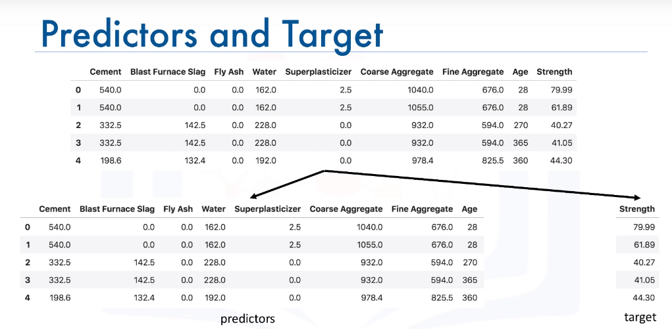
Regression Model with Keras

Slide 15
